Slide 1
UNSUPERVISED LEARNING
Dimensionality Reduction & Anomaly Detection
PCA • Isolation Forest • Credit-Card Fraud Use Case

Slide 2
Agenda
01
Unsupervised Learning, Briefly
Where these two algorithms fit in the ML landscape
02
Dimensionality Reduction — PCA
Concept, mechanics, and real-world applications
03
Anomaly Detection — Isolation Forest
Concept, mechanics, and real-world applications
04
Finance Use Case
Credit-card fraud detection, pipeline and results

Slide 3


Where These Algorithms Fit
Unsupervised learning finds structure in data with no labeled outcomes
Dimensionality
Reduction
Anomaly Detection
Compresses many features into fewer informative ones — today's PCA
Flags records that don't fit the pattern — today's Isolation Forest

Slide 4
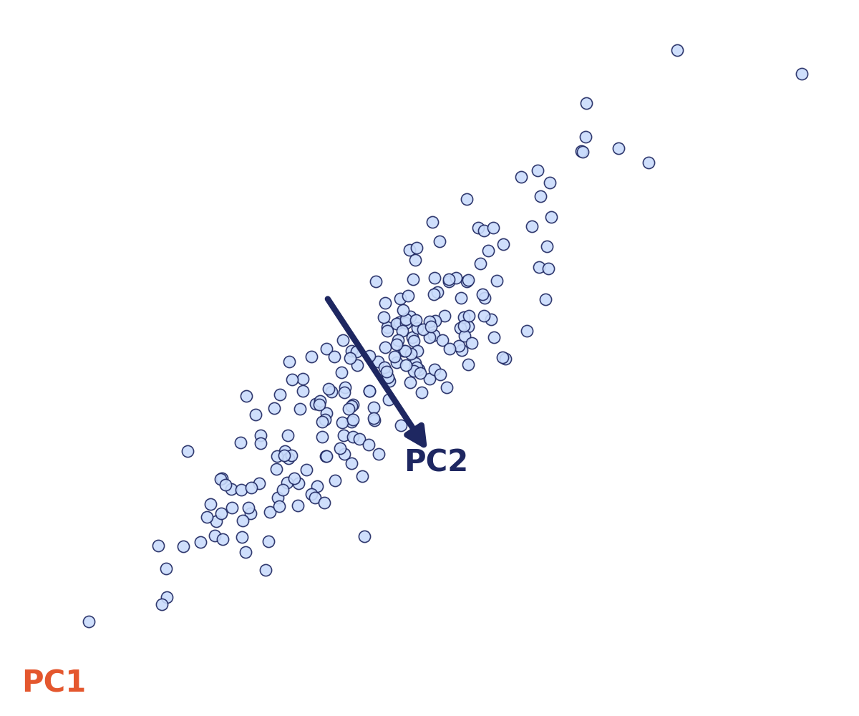
Correlated data, projected onto its principal axes
PC1
ALGORITHM 1
Direction of maximum variance
Principal Component
Analysis (PCA)
PC2
Orthogonal, next-highest variance
A dimensionality-reduction technique that re-expresses correlated features as a smaller set of uncorrelated “principal components,” ranked by how much variance they explain.
Key idea: keep the axes that carry the most signal, drop the ones that mostly carry noise.

Slide 5
How PCA Works
Four steps, purely geometric — no target variable involved
1
2
3
4
Standardize
Covariance
Eigen-decompose
Project
Center and scale every feature so no single one dominates by magnitude alone.
→
Compute the covariance matrix capturing how features move together.
→
Find eigenvectors (directions) and eigenvalues (variance explained) of that matrix.
→
Re-express the data on the top-k eigenvectors — the principal components.

Slide 6




Where PCA Is Used
Any domain with many correlated, high-dimensional features
Finance
Image Compression
Compress dozens of correlated risk/transaction features before modeling
Reduce pixel dimensionality while preserving visual structure
Noise Reduction
Visualization
Drop low-variance components that mostly encode measurement noise
Project high-dimensional data to 2D/3D for exploratory plots

Slide 7
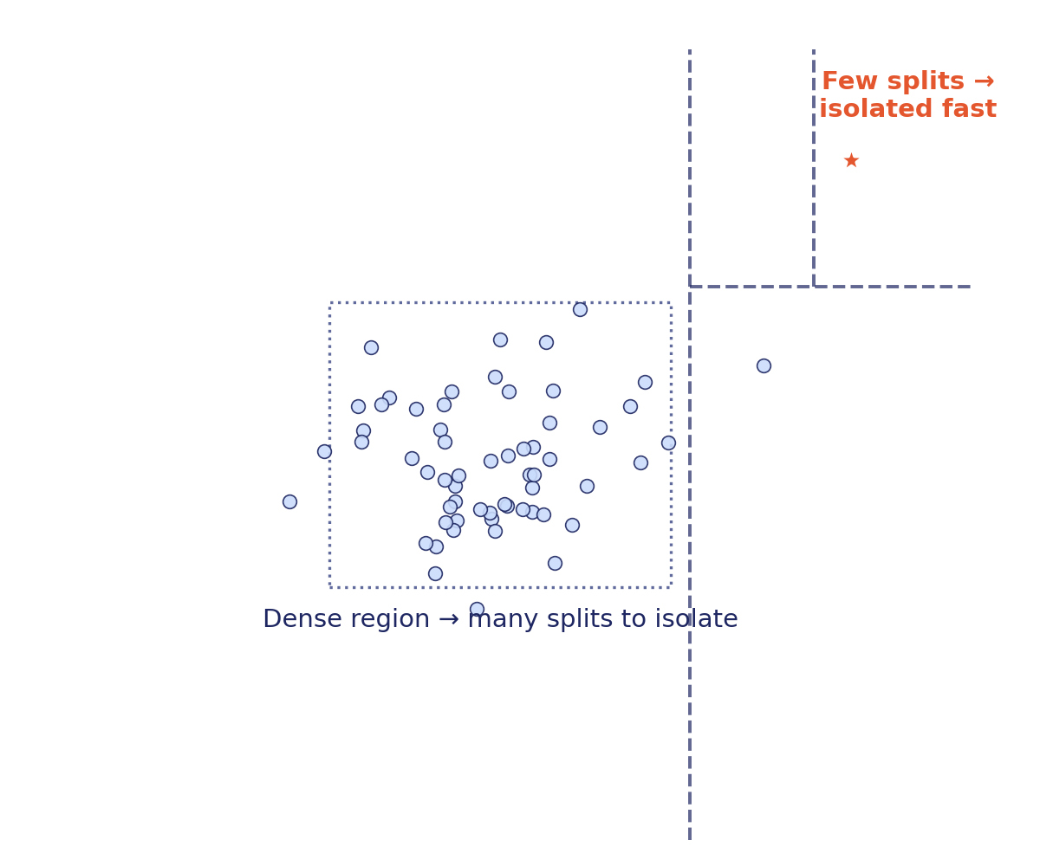
Random partitioning isolates outliers in far fewer splits
ALGORITHM 2
Isolation Forest
An anomaly-detection method built on random decision trees. Instead of profiling “normal,” it directly measures how easy each point is to isolate.

Slide 8
How Isolation Forest Works
An ensemble of random “isolation trees,” scored by average path length
1
2
3
4
Random Split
Partition
Path Length
Ensemble Score
Pick a random feature, then a random split value between its min and max.
→
Recursively repeat, building a tree where each split isolates points further.
→
Count the splits needed to isolate each point — shorter paths, more unusual.
→
Average path length across many random trees becomes the anomaly score.
Score close to 1 = likely anomaly (short average path). Score close to 0 = likely normal (long average path, deep in the tree).

Slide 9



Where Isolation Forest Is Used
Anywhere rare, abnormal events matter more than the average case
Fraud Detection
Cybersecurity
Flag credit-card, insurance, or wire-transfer transactions that break normal patterns
Detect network intrusions and unusual login or access behavior
Quality Control
IT Operations
Spot defective units on a production line from sensor data
Surface abnormal system metrics before they become outages

Slide 10

FINANCE USE CASE
Credit-Card Fraud Detection
Combining both algorithms into one lightweight, unsupervised pipeline
Raw Transactions
→
PCA
→
Isolation Forest
→
Flagged Cases
Amount, time, merchant category, and behavioral features per transaction
Compress correlated features into a small set of components — faster, less noisy
Score each transaction by how easily it's isolated in the reduced space
High-score transactions routed to fraud analysts for review

Slide 11
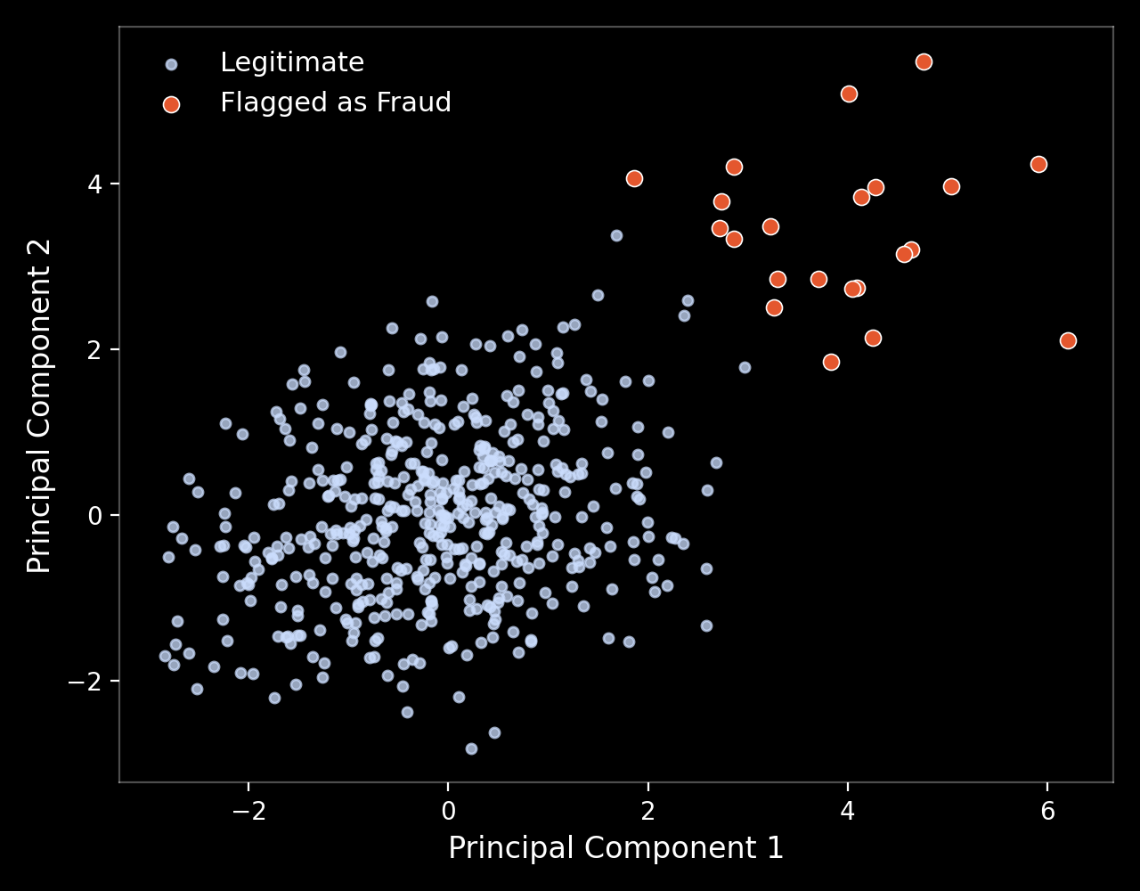
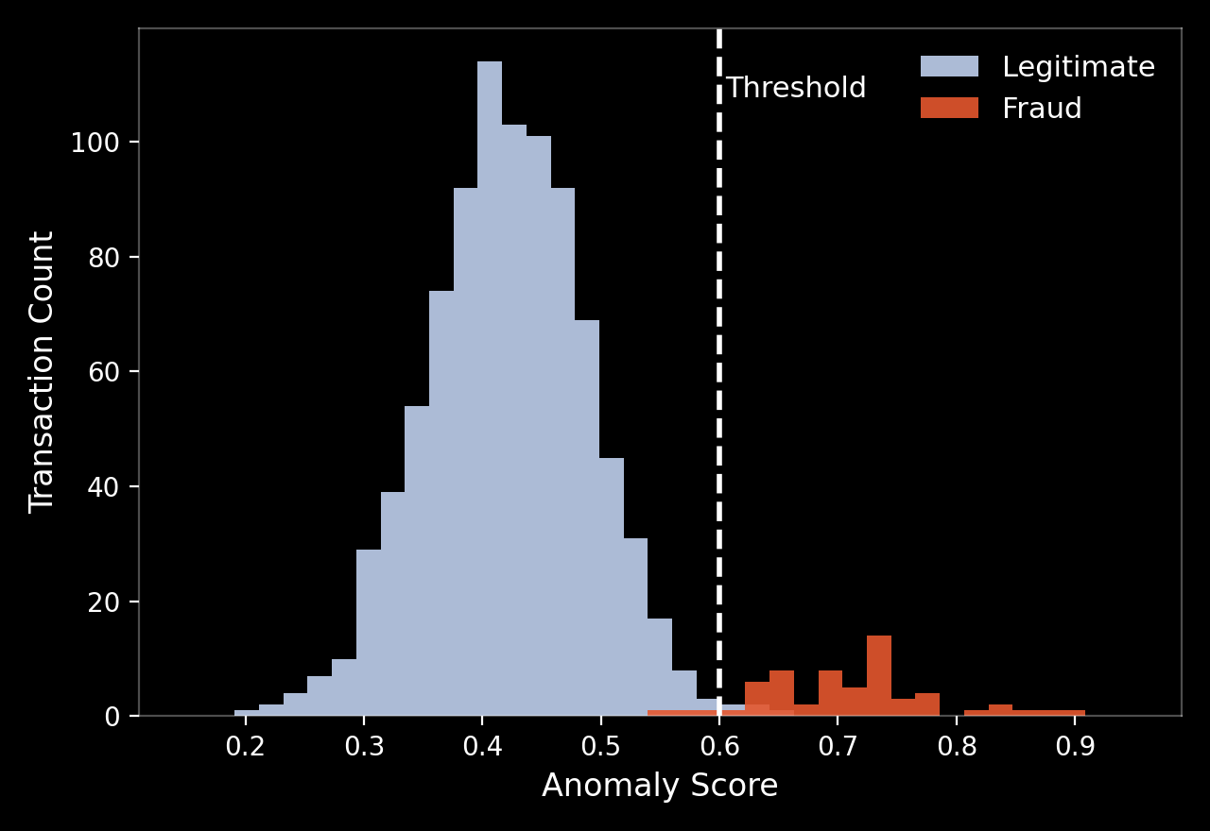
Use Case Results
Illustrative output from the accompanying notebook
500
Simulated legitimate transactions
22
Simulated fraudulent transactions
0.60
Anomaly-score threshold used

Slide 12
Thank You

